Slide 1
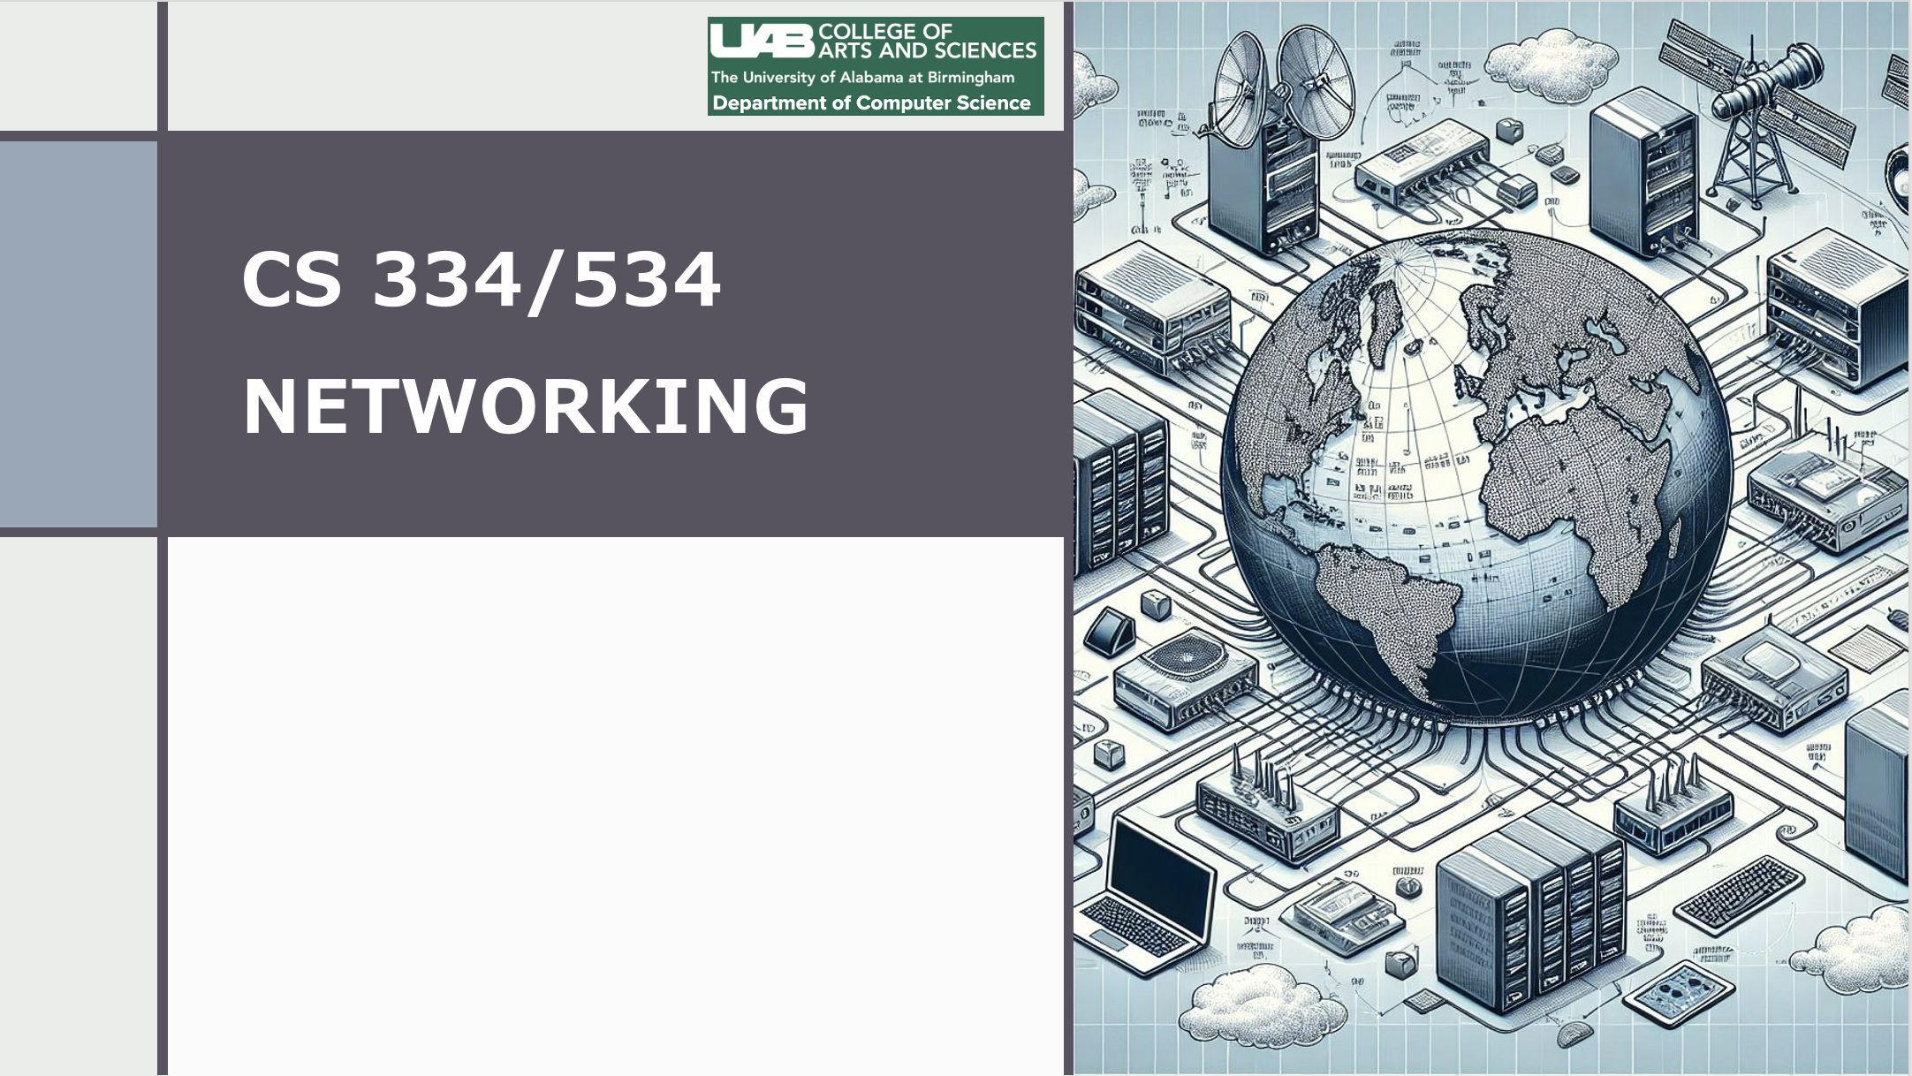
Dr. Ragib Hasan
Lecture 1.2:
Network Terminology and Foundational Concepts

Slide 2
Lecture goals
Introduce various network concepts
Discuss network terminology
Book reference: Chapter 1, section 1.1 to 1.4

Slide 3

Fundamental question
How do we send data from the source to the destination over a set of communication lines?

Slide 4
Let’s take a step back and think about the challenges!
We have data files of various sizes and formats
Network connections will be shared by multiple users
We need to find a way to reach the destination
Our computers need to connect to the nearby network access point (also shared by multiple users)
Also, there is a lot of heterogeneity (not everyone will be using the same hardware or software). Even then, everything must work correctly.

Slide 5
So, how do we solve this (messy) problem?
Key hunches
Figure out the problems and group them into layers, with each layer focused on a single problem
Develop protocols (or rules of engagement) for each of the layers
Break down data into chunks and encapsulate them into standard “Envelopes” (just like we do when sending letters via post)

Slide 6
Let’s do an analogy
Suppose you want to send a letter to your friend living in a different city
Would you send the letter all the way to your friends or manage every step? No!
What would you do?
  You’d pack the letter in an envelop, write the destination address, and hand it to the post office.
  The post office will check the address and depending on the address, would put the envelop in a mail bag corresponding to the destination. and put it in a mail truck.
  The truck driver will drive it to the destination city.
  There, the reverse would happen – the mail bag will be unloaded from the truck,
  Then the letter will be retrieved, and then taken by the postman to your friend’s house.
Key insight – don’t try to manage everything yourself. Rather, separate the tasks into groups or “layers”, and let each layer focus on doing a single thing in the most efficient way!

Slide 7
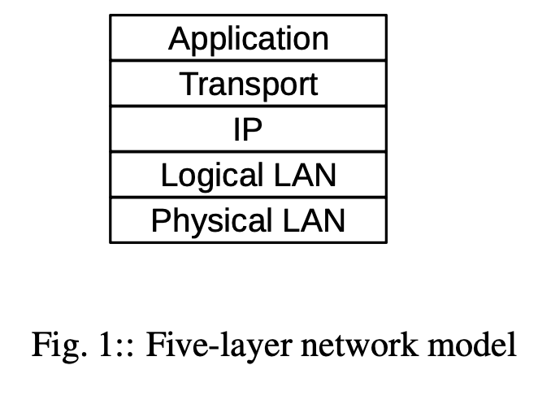
Network Layers
** This is an informal model, we will cover the TCP/IP and OSI models in another lecture

Slide 8
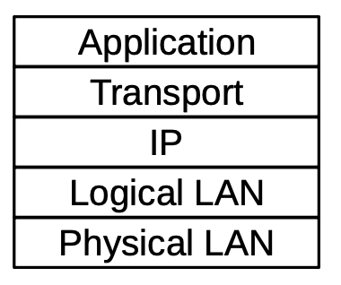
The idea of a “Layer”
A layer corresponds strongly to the idea of a programming interface or library, with the understanding that a given layer communicates directly only with the two layers immediately above and below it.
An application hands off a chunk of data to the TCP library, which in turn makes calls to the IP library, which in turn calls the LAN layer for actual delivery.
An application does not interact directly with the IP and LAN layers at all.

Slide 9
What does each layer do?
Application layer – This is where applications such as browsers, email clients, etc. work.
Transport layer – manages traffic and ensures proper delivery of data
IP layer – breaks data into packets or datagrams and ensures routing of them to the destination.
LAN layers or link layers – focuses on point to point data exchange over communication lines

Slide 10
How fast and how much?
Data rate/bandwidth: The rate at which bits are transmitted. (depends on line’s speed)
Throughput: Refers to the overall effective transmission rate, taking into account things like transmission overhead, protocol inefficiencies and perhaps even competing traffic. It is generally measured at a higher network layer than the data rate.
  Why is throughput generally less than data rate?
Goodput: sometimes used to refer to what might also be called “application-layer throughput”: the amount of usable data delivered to the receiving application.
  Why is it different from throughput?

Slide 11
Bits, Bytes, bps, Bps
Data rates are generally measured in kilobits per second (kbps) or megabits per second (Mbps);
the use of the lower-case “b” here denotes bits.
In the context of data rates, a kilobit is 10³ bits (not 2¹⁰) and a megabit is 10⁶ bits. Somewhat inconsistently, we follow the tradition of using kB and MB to denote data volumes of 2¹⁰ and 2²⁰ bytes respectively, with the upper-case B denoting bytes.
Question: If your phone gets 500 Mbps network speeds in speed test, how many bytes would that be?
Question: At that speed, how long will it take to transmit a 1 MB file?
1 Mbps = 10⁹ bits per second. So, 500 Mbps = 500*10⁹ / 8 bytes per second = 62,500,000 bytes per second.

Slide 12
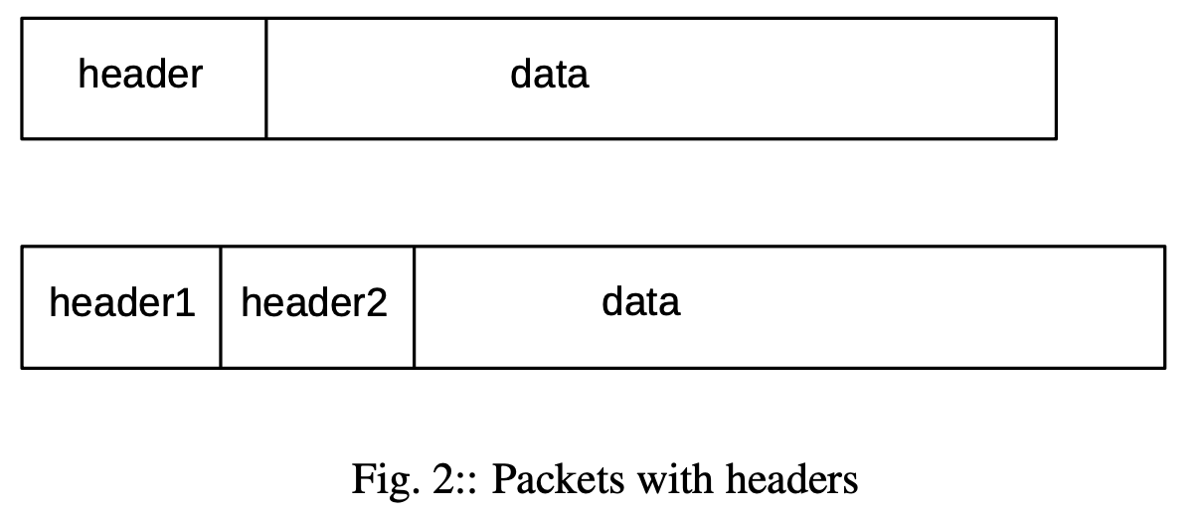
Packet
At the heart of networking is the concept of a Packet
A packet is defined as a modest-sized sequences of bytes, transmitted as a unit through some shared set of links
Packets have a header with delivery information (address) and other meta data.

Slide 13
Do we want large or small packets?
Packets are often small in size
Ethernet = 1500 bytes
TCP = up to 64 kilobytes, BUT in practice, limited to 1500 bytes
What is the advantage of small packets over large?

Slide 14
Packet headers
Each layer adds its own header
For example,
Ethernet = 14 bytes
IP = 20 bytes
TCP = 20 bytes
A TCP packet sent over IP over Ethernet will have (14+20+20=54 bytes of headers).

Slide 15
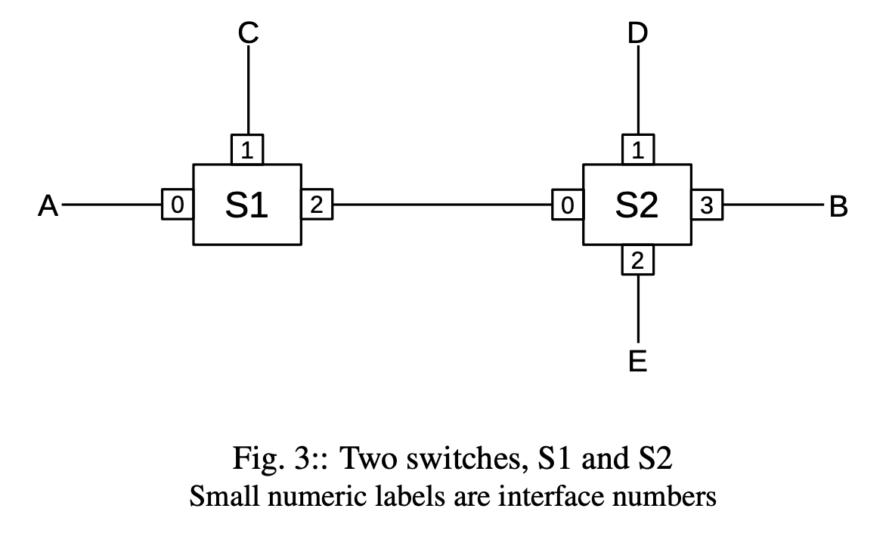
How packets move?
Packet-switching is the foundation of today’s networks
In network switches, data arrives over an input line/interface and is forwarded to another line/interface based on packet destination address

Slide 16
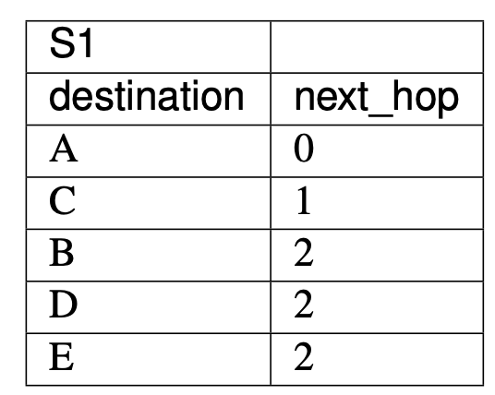
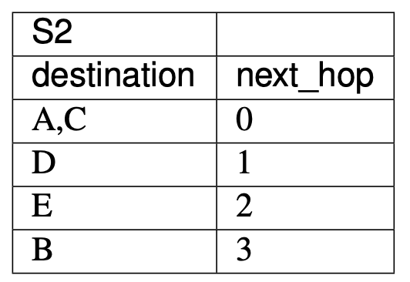
How packets move?
Each switch maintains a switching or forwarding table
The table shows what line an incoming packet should be forwarded to based on packet destination
IMPORTANT: Packet switching is stateless – each packet is handled separately (in isolation).
  Why?

Slide 17
Switches vs Routers
Switching devices acting at the LAN layer and forwarding packets based on the LAN address are called switches
Switching devices acting at the IP layer and forwarding on the IP address are called routers.

